Slide 1
1.Link Tag & Insert Image Tags
<a href="a.html "> Click here to view the content of A.html File</a> <hr>
<HR SIZE=10 WIDTH="100%">
<img src="flower.jpg" width="32" height="32" align="bottom"/></a> <hr>

Slide 2
2. Frames First Create 2 HTML [ FILES 1. A.html & B.html ] <!A.html File -- >
<html>
<head>
<h1>A.html file</h1>
<title> </title> </head>
<body>
<p> This is the content of A.HTML File</p>
</body>
</html>

Slide 3
What are HTML Coding?
Hypertext Mark-up Language (HTML) is the coding that aids browsers in reading online
documents.

Slide 4
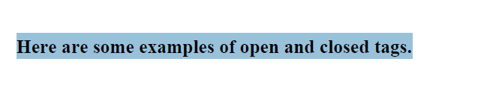

Slide 5
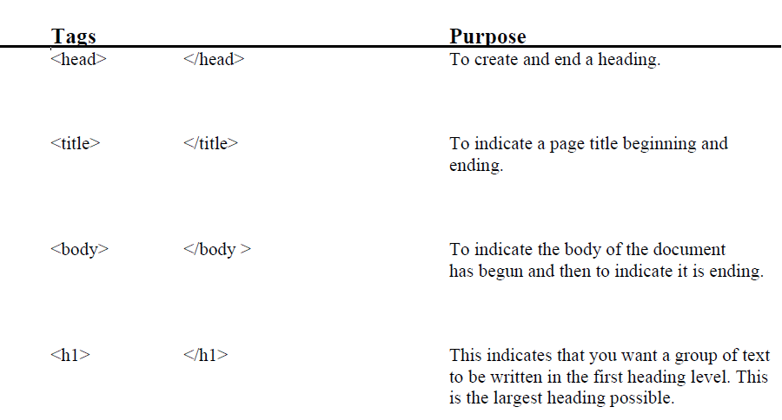

Slide 6
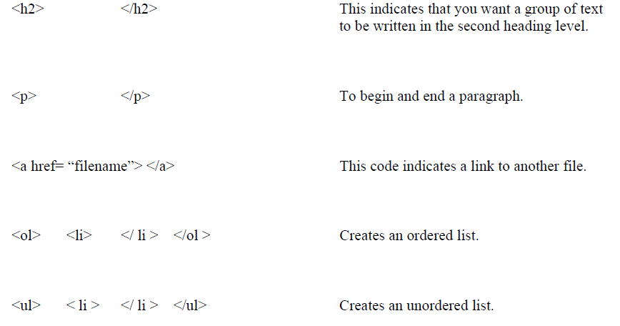

Slide 7
<!B.html File -- >
<html>
<head>
<h1>B.html file</h1>
<title> </title> </head>
<body>
<p> This is the content of B.HTML File</p>
</body>
<HTML>

Slide 8
3.Order List <!-- A Program to illustrate Order List tag -->
<body>
<ol>
<li>Apples</li>
<li>Bananas</li>
<li>Lemons</li>
.
.
</ol>
</body>

Slide 9
4.Tables
<body>
<table border="1">
<tr>
<th>Name</th><th>Rank</th>
</tr>
<tr>
<td>Messy</td><td>1</td>
</tr>
<tr>
<td>Neymar</td><td>2</td>
</tr>
<tr>
<td>&nbsp;</td><td>&nbsp;</td>
</tr>
</table>

Slide 10
5.To Print a Text with different Colour & Font
<body>
<font face="arial" size="1" color="blue"> WELCOME </font> <br>
<font size="2" color="cyan"> WELCOME </font> <br>
<font size="3" color="red"> WELCOME </font> <br>
<font size="4" color="yellow"> WELCOME </font> <br>
<font size="5" color="green"> WELCOME </font> <br>
<font size="6" color="brown"> WELCOME </font> <br>
<font size="7" color="pink"> WELCOME </font> <br>
<font size="20" color="gray"> WELCOME </font> <br>
</body>

